Slide 1

555 TIMER

Slide 2
555 Timer
Introduction:
The 555 Timer is one of the most popular and versatile integrated circuits ever produced!
“Signetics” Corporation first introduced this device as the SE/NE 555 in early 1970.
It is a combination of digital and analog circuits.
It is known as the “time machine” as it performs a wide variety of timing tasks.
Applications for the 555 Timer include:
Ramp and Square wave generator
Frequency dividers
Pulse generators and LED flashers

Slide 3
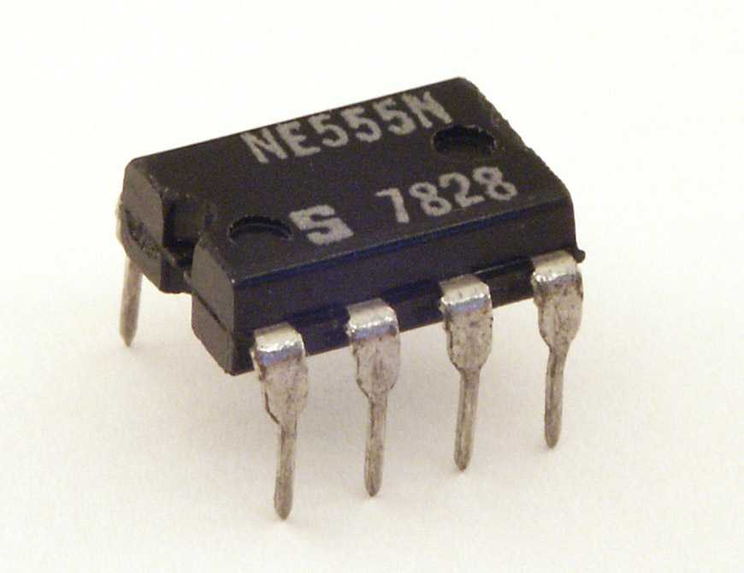
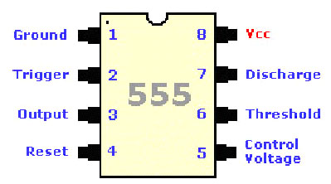
555 timer- Pin Diagram
The 555 timer is an 8-Pin D.I.L. Integrated Circuit or ‘chip’
Notch
Pin 1

Slide 4
555 timer- Pin Description
Pin | Name | Purpose
1 | GND | Ground, low level (0 V)
2 | TRIG | OUT rises, and interval starts, when this input falls below 1/3 V_{CC}.
3 | OUT | This output is driven to approximately 1.7V below +V_{CC} or GND.
4 | RESET | A timing interval may be reset by driving this input to GND, but the timing does not begin again until RESET rises above approximately 0.7 volts. Overrides TRIG which overrides THR.
5 | CTRL | "Control" access to the internal voltage divider (by default, 2/3 V_{CC}).
6 | THR | The interval ends when the voltage at THR is greater than at CTRL.
7 | DIS | Open collector output; may discharge a capacitor between intervals. In phase with output.
8 | V+, V_{CC} | Positive supply voltage is usually between 3 and 15 V.

Slide 5
555 Timer
Description:
Contains 25 transistors, 2 diodes and 16 resistors
Maximum operating voltage 16V
Maximum output current 200mA
Best treated as a single component with required
input and output
INPUT
PROCESS
OUTPUT
If you input certain signals they will be processed / controlled in a certain manner and will produce a known output.

Slide 6
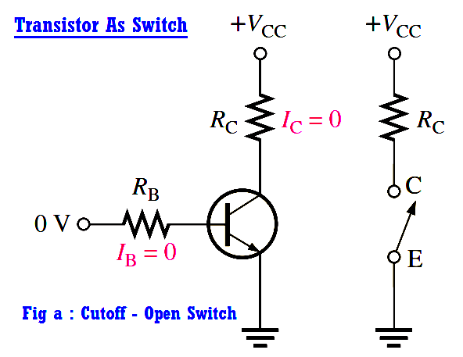

Slide 7
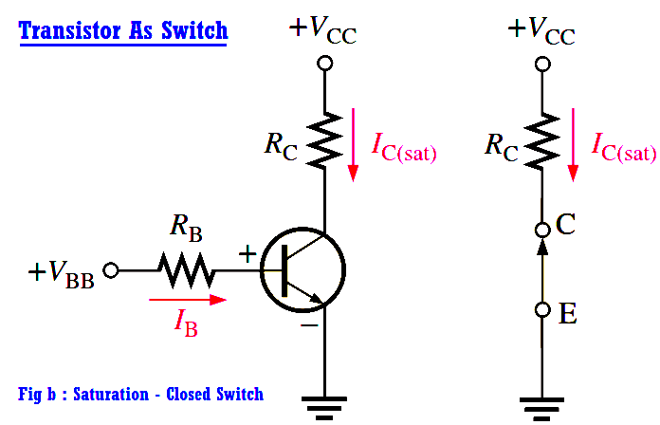

Slide 8
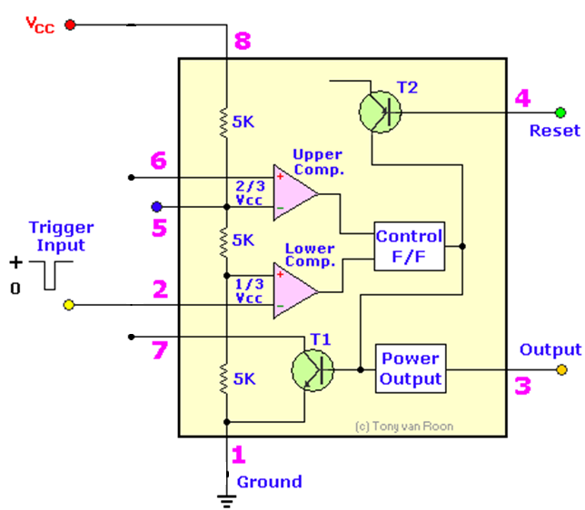
Inside the 555 Timer
+
Truth Table
Vref
S | R | Q | Q
0 | 0 | No Change
0 | 1 | 0 | 1
1 | 0 | 1 | 0
1 | 1 | X | X
Threshold
Control Voltage
R
Q
-
S
Q
Trigger
Discharge
Fig: Functional Diagram of 555 Timer

Slide 9
Inside the 555 Timer
Operation:
The voltage divider has three equal 5K resistors. It divides the input voltage (Vcc) into three equal parts.
The two comparators are op-amps that compare the voltages at their inputs and saturate depending upon which is greater.
The Threshold Comparator saturates when the voltage at the Threshold pin (pin 6) is greater than (2/3)Vcc.
The Trigger Comparator saturates when the voltage at the Trigger pin (pin 2) is less than (1/3)Vcc

Slide 10
Inside the 555 Timer
The flip-flop is a bi-stable device. It generates two values, a “high” value equal to Vcc and a “low” value equal to 0V.
When the Threshold comparator saturates, the flip flop is Reset (R) and it outputs a low signal at pin 3.
When the Trigger comparator saturates, the flip flop is Set (S) and it outputs a high signal at pin 3.
The transistor is being used as a switch, it connects pin 7 (discharge) to ground when it is closed.
When Q is low, Q bar is high. This closes the transistor switch and attaches pin 7 to ground.
When Q is high, Q bar is low. This open the switch and pin 7 is no longer grounded

Slide 11
Uses of 555 timer
What the 555 timer is used for:
To switch on or off an output after a certain time delay i.e.
Games timer, Exercise timer.
To continually switch on and off an output i.e.
warning lights, Bicycle indicators.
As a pulse generator i.e.
To provide a series of clock pulses for a counter.

Slide 12
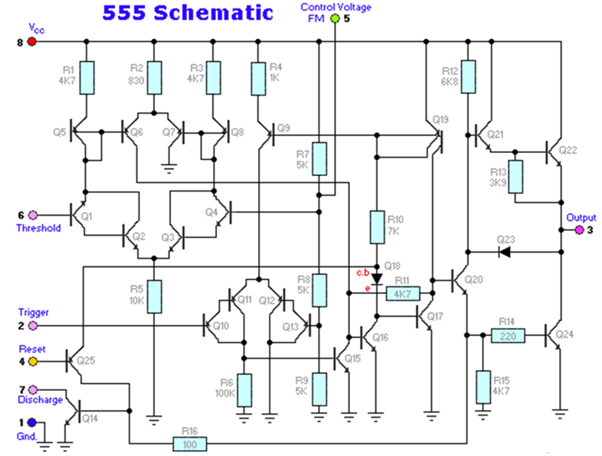
Schematic Diagram of 555 Timer

Slide 13
555 Timer operating modes
The 555 has three operating modes:
1. Monostable Multivibrator
2.Astable Multivibrator
3. Bistable Multivibratior

Slide 14
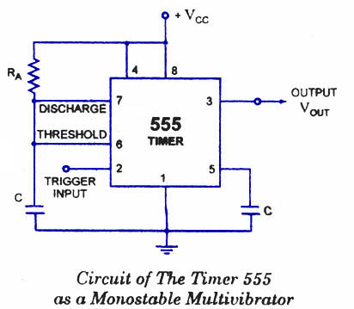
555 Timer as Monostable Multivibrator
Description:
In the standby state, FF holds transistor Q1 ON, thus clamping the external timing capacitor C to ground. The output remains at ground potential. i.e. Low.
As the trigger passes through VCC/3, the FF is set, i.e. Q bar=0, then the transistor Q1 OFF and the short circuit across the timing capacitor C is released. As Q bar is low , output goes HIGH.

Slide 15
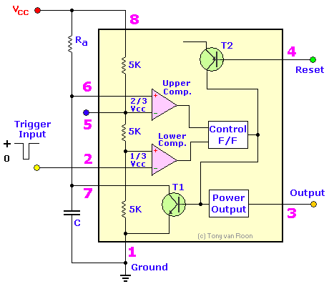
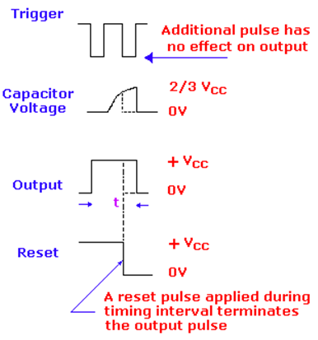
555 Timer as Monostable Multivibrator
Fig (a): Timer in Monostable Operation with Functional Diagram
Fig (b): Output wave Form of Monostable

Slide 16
Monostable Multivibrator- Description
Voltage across it rises exponentially through R towards Vcc with a time constant RC.
After Time Period T, the capacitor voltage is just greater than 2Vcc/3 and the upper comparator resets the FF, i.e. R=1, S=0. This makes Q bar =1, C rapidly to ground potential.
The voltage across the capacitor as given by,
If –ve going reset pulse terminal (pin 4) is applied, then transistor Q2-> OFF, Q1-> ON & the external timing capacitor C is immediately discharged.
at

Slide 17
Behavior of the Monostable Multivibrator
The monostable multivibrator is constructed by adding an external capacitor and resistor to a 555 timer.
The circuit generates a single pulse of desired duration when it receives a trigger signal, hence it is also called a one-shot.
The time constant of the resistor-capacitor
combination determines the length of the pulse.

Slide 18
Uses of the Monostable Multivibrator
Used to generate a clean pulse of the correct height and duration for a digital system
Used to turn circuits or external components on or off for a specific length of time.
Used to generate delays.
Can be cascaded to create a variety of sequential timing pulses. These pulses can allow you to time and sequence a number of related operations.

Slide 19
Monostable Multivibrator
Problem:
In the monostable multivibrator of fig, R=100kΩ and the time delay T=100ms. Calculate the value of C ?
Solution:
T=1.1RC

Slide 20
Applications in Monostable Mode
Missing Pulse Detector.
Linear Ramp Generator.
Frequency Divider.
Pulse Width Modulation.

Slide 21
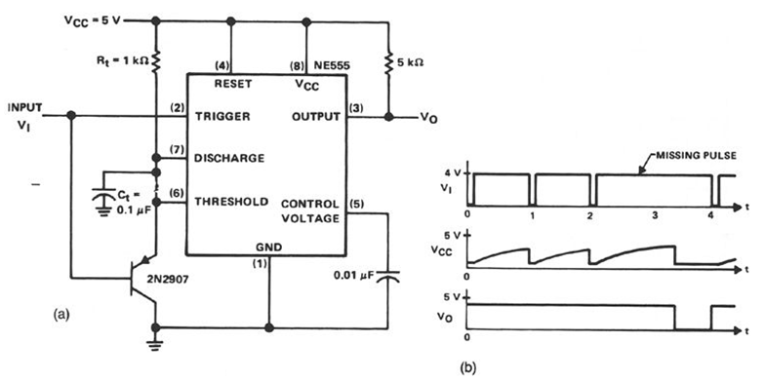
1.Missing Pulse Detector
Fig (a) : A missing Pulse Detector Monostable Circuit
Fig (b) : Output of Missing Pulse Detector

Slide 22
Missing Pulse Detector- Description
When input trigger is Low, emitter-base diode of Q is forwarded biased capacitor is clamped to 0.7v(of diode), output of timer is HIGH width of T o/p of timer > trigger pulse width.
T=1.1RC select R & C such that T > trigger pulse.
Output will be high during successive coming of input trigger pulse. If one of the input trigger pulse missing trigger i/p is HIGH, Q is cut off, timer acts as normal monostable state.
It can be used for speed control and measurement.

Slide 23
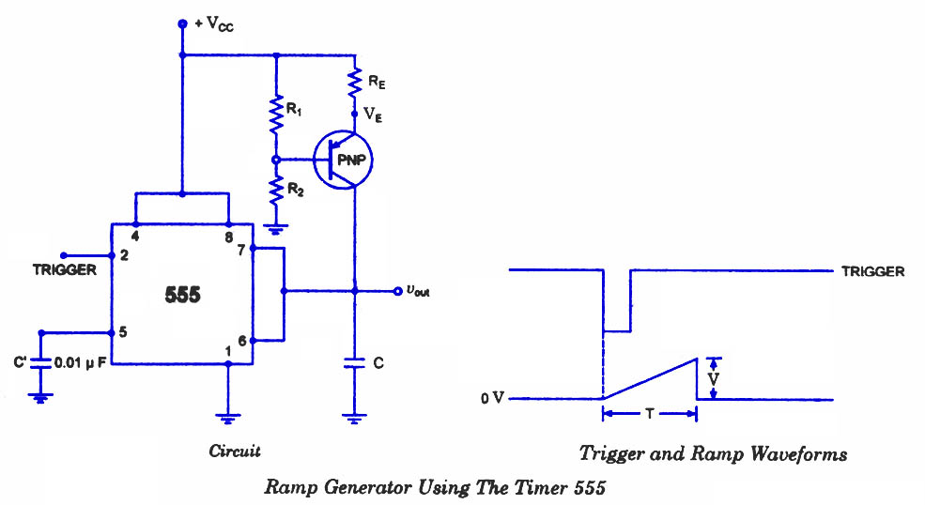
2.Linear Ramp Generator
at pin 2 > Vcc/3
Capacitor voltage at pin 6

Slide 24
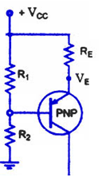
Linear Ramp Generator- Description
Analysis:
Applying KVL around base-emitter loop of Q3
Q3
i
Ic
Voltage Capacitor,
When becomes at T,

Slide 25
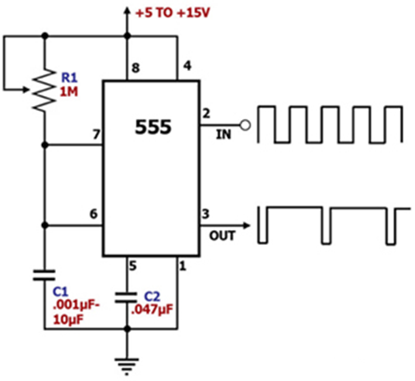
3.Frequency Divider
Description:
A continuously triggered monostable circuit when triggered by a square wave generator can be used as a frequency divider, if the timing interval is adjusted to be longer than the period of the triggering square wave input signal.
The monostable multivibrator will be triggered by the first negative going edge of the square wave input but the output will remain HIGH(because of greater timing interval) for next negative going edge of the input square wave as shown fig.
Fig: Diagram of Frequency Divider

Slide 26
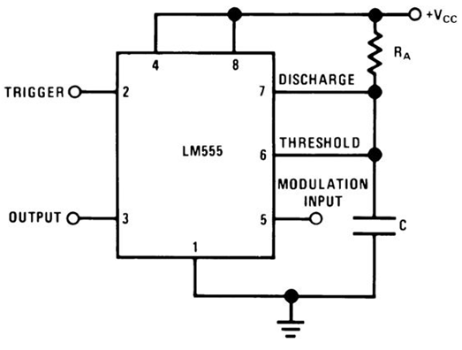
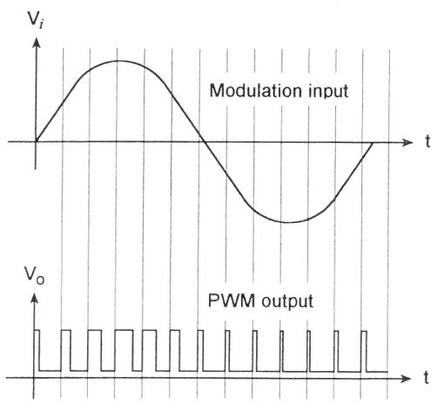
4.Pulse Width Modulation
Fig a: Pulse Width Modulation
Fig b: PWM Wave Forms

Slide 27
Pulse Width Modulation- Description
The charging time of capacitor is entirely depend upon 2Vcc/3. When capacitor voltage just reaches about 2Vcc/3 output of the timer is coming from HIGH to Low level.
We can control this charging time of the capacitor by adding continuously varying signal at the pin-5 of the 555 timer which is denoted as control voltage point. Now each time the capacitor voltage is compared control voltage according to the o/p pulse width change. So o/p pulse width is changing according to the signal applied to control voltage point. So the output is pulse width modulated form.

Slide 28
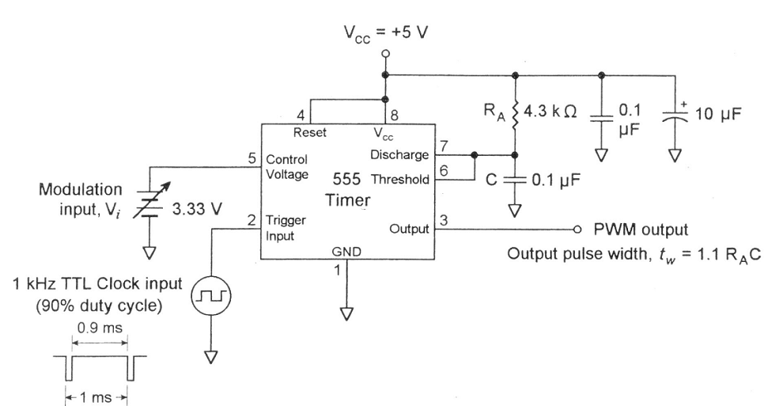
Pulse Width Modulation
Practical Representation
Fig: PWM & Wave forms

Slide 29
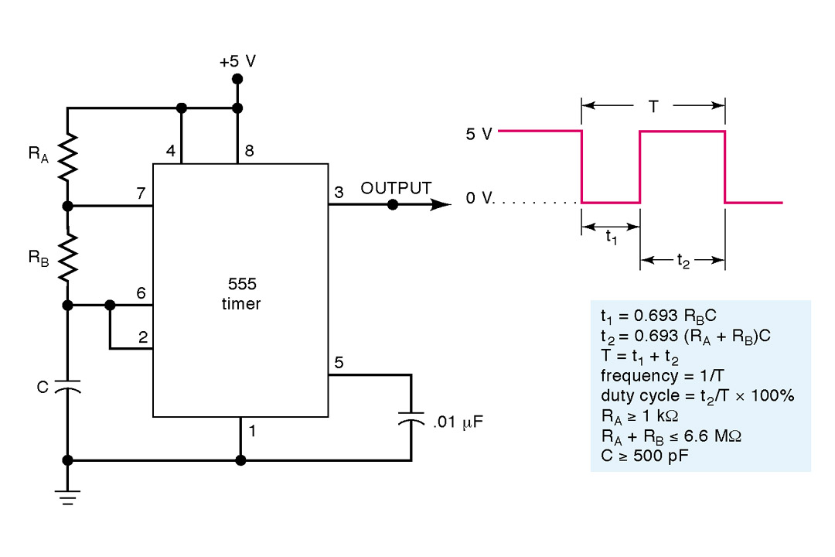
Astable Multivibrator
Fig (a): Diagram of Astable Multvibrator
1 – Ground 5 – FM Input (Tie to gnd via bypass cap)
2 – Trigger 6 – Threshold
3 – Output 7 – Discharge
4 – Reset (Set HIGH for normal operation) 8 – Voltage Supply (+5 to +15 V)

Slide 30
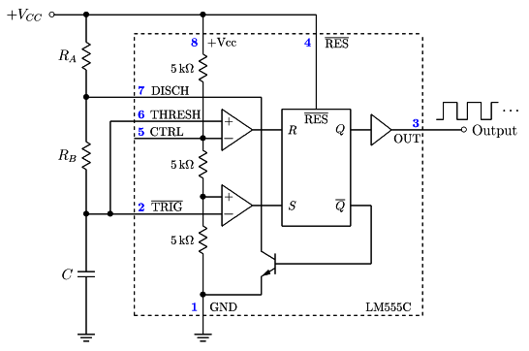
Astable Multivibrator
R1
VA
A1
A1
Vo
V1
R2
V2
A2
A2
VC
VT
R3
Q1
Fig (b): Functional Diagram of Astable Multivibrator using 555 Timer

Slide 31
Astable Multivibrator- Description
Connect external timing capacitor between trigger point (pin 2) and Ground.
Split external timing resistor R into RA & RB, and connect their junction to discharge terminal (pin 7).
Remove trigger input, monostable is converted to Astable multivibrator.
This circuit has no stable state. The circuits changes its state alternately. Hence the operation is also called free running oscillator.

Slide 32
Astable 555 Timer Block Diagram Contents
Resistive voltage divider (equal resistors) sets threshold voltages for comparators
V₁ = V_{TH} = 2/3 V_{CC} V₂ = V_{TL} = 1/3 V_{CC}
Two Voltage Comparators
For A1, if V₊ > V_{TH} then R =HIGH
For A2, if V₋ < V_{TL} then S = HIGH
RS FF
If S = HIGH, then FF is SET, = LOW, Q1 OFF, V_{OUT} = HIGH
If R = HIGH, then FF is RESET, = HIGH, Q1 ON, V_{OUT} = LOW
Transistor Q₁ is used as a Switch

Slide 33
Operation of a 555 Astable
Assume initially that the capacitor is discharged.
For A1, V₊ = V_{C} = 0V and for A2, V₋ = V_{C} = 0V, so R=LOW, S=HIGH, = LOW , Q1 OFF, V_{OUT} = V_{CC}
Now as the capacitor charges through R_{A} & R_{B}, eventually V_{C} > V_{TL} so R=LOW & S=LOW.
FF does not change state.
R_{A} R_{B}
V_{C}(t)
V_{CC}

Slide 34
Operation of a 555 Astable Continued……
Once V_{C} ≥ V_{TH}
R=HIGH, S=LOW, = HIGH ,Q1 ON, V_{OUT} = 0
Capacitor is now discharging through R_{B} and Q₁ to ground.
Meanwhile at FF, R=LOW & S=LOW since
V_{C} < V_{TH}.
R_{B}
V_{C}(t)
Q1

Slide 35
Operation of a 555 Astable Continued…..
Once V_{C} < V_{TL}
R=LOW, S=HIGH, = LOW , Q1 OFF, V_{OUT} = V_{CC}
Capacitor is now charging through R_{A} & R_{B} again.
R_{A} R_{B}
V_{C}(t)
V_{CC}

Slide 36




Timing Diagram of a 555 Astable
V_{C}(t)
V_{TH}
V_{TL}
1 2 3
t
V_{OUT}(t)
T_{L}
T_{H}
t
t = 0 t = 0'

Slide 37
Astable Multivibrator- Analysis
The capacitor voltage for a low pass RC circuit subjected to a step input of Vcc volts is given by,
The time t1 taken by the circuit to change from 0 to 2Vcc/3 is,
The time t2 to charge from 0 to vcc/3 is
So the time to change from Vcc/3 to 2Vcc/3 is,
So, for the given circuit,
…… Charging time
The output is low while the capacitor discharges from 2Vcc/3 to Vcc/3 and the voltage across the capacitor is given by,
Contd….

Slide 38
Astable Multivibrator- Analysis
After solving, we get, t=0.69RC
For the given circuit,
…… Discharging time
Both RA and RB are in the charge path, but only RB is in the discharge path.
The total time period,
Frequency,
…….1.45 is Error Constant
Duty Cycle,

Slide 39
Behavior of the Astable Multivibrator
The astable multivibrator is simply an oscillator. The astable multivibrator generates a continuous stream of rectangular off-on pulses that switch between two voltage levels.
The frequency of the pulses and their duty cycle are dependent upon the RC network values.
The capacitor C charges through the series resistors R_{A} and R_{B} with a time constant (R_{A} + R_{B})C.
The capacitor discharges through R_{B} with a time constant of R_{B}C

Slide 40
Uses of the Astable Multivibrator
Flashing LED’s
Pulse Width Modulation
Pulse Position Modulation
Periodic Timers
Uses include LEDs, pulse generation, logic clocks, security alarms and so on.

Slide 41
Applications in Astable Mode
Square Generator
FSK Generator
Pulse Position Modulator

Slide 42
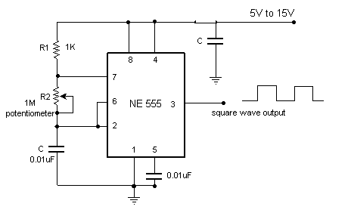
1.Square Generator
3
10µF
C1
Fig: Square Wave Generator
To avoid excessive discharge current through Q1 when R1=0 connect a diode across R2, place a variable R in place of R1.
Charging path R1 & D; Discharging path R2 & pin 7.

Slide 43
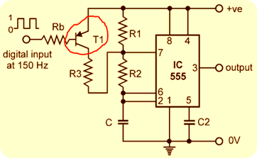
2. FSK Generator
Description:
In digital data communication, binary code is transmitted by shifting a carrier frequency between two preset frequencies. This type of transmission is called Frequency Shift Keying (FSK) technique.
Fig: FSK Generator
Contd…..

Slide 44
FSK Generator
A 555 timer is astable mode can be used to generate FSK signal.
When input digital data is HIGH, T1 is OFF & 555 timer works as normal astable multivibrator.
The frequency of the output wave form given by,
When input digital is LOW, Q1 is ON then R3 parallel R1

Slide 45
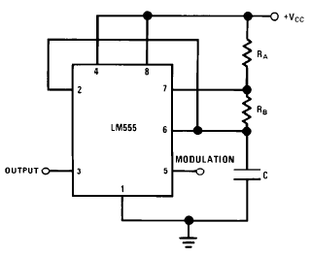
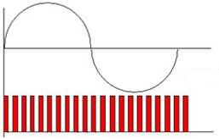
2. Pulse Position Modulator
Description:
The pulse position modulator can be constructed by applying a modulating signal to pin 5 of a 555 timer connected for astable operation.
The output pulse position varies with the modulating signal, since the threshold voltage and hence the time delay is varied.
The output waveform that the frequency is varying leading to pulse position modulation.
Fig (a): Pulse position Modulator
Fig (b): Output Wave Form of PPM

Slide 46
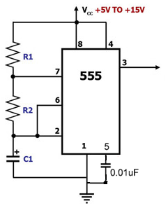
Astable Multivibrator
Problem:
In the astable multivibrator of fig, RA=2.2KΩ, RB=3.9K Ω and C=0.1µF. Determine the positive pulse width tH, negative pulse width tLow, and free-running frequency fo.
Solution:
Duty Cycle,

Slide 47
Comparison of Multivibrator Circuits
Monostable Multivibrator | Astable Multivibrator
1. It has only one stable state | 1. There is no stable state.
2. Trigger is required for the operation to change the state. | 2. Trigger is not required to change the state hence called free running.
3. Two components R and C are necessary with IC 555 to obtain the circuit. | 3. Three components RA, RB and C are necessary with IC 555 to obtain the circuit.
4. The pulse width is given by T=1.1RC Seconds | 4. The frequency is given by,
5. The frequency of operation is controlled by frequency of trigger pulses applied. | 5. The frequency of operation is controlled by RA, RB & C.
6. The applications are timer, frequency divider, pulse width modulation etc… | 6. The applications are square wave generator, flasher, voltage controlled oscillator, FSK Generator etc..

Slide 48
Features of IC 555 Timer
The Features of IC 555 Timer are:
1. The 555 is a monolithic timer device which can be used to produce accurate and highly stable time delays or oscillation. It can be used to produce time delays ranging from few microseconds to several hours.
2. It has two basic operating modes: monostable and astable.
3. It is available in three packages: 8-pin metal can, 8-pin mini DIP or a 14-pin. A 14-pin package is IC 556 which consists of two 555 times.

Slide 49
Features of IC 555 Timer
4. The NE 555( signetics ) can operate with a supply voltage in the range of 4.5v to 18v and output currents of 200mA.
5. It has a very high temperature stability, as it is designed to operate in the temperature range of -55⁰c to 125ºc.
6. Its output is compatible with TTL, CMOS and Op-Amp circuits.

